Slide 1
sunhaotai
Jilin University

Slide 2
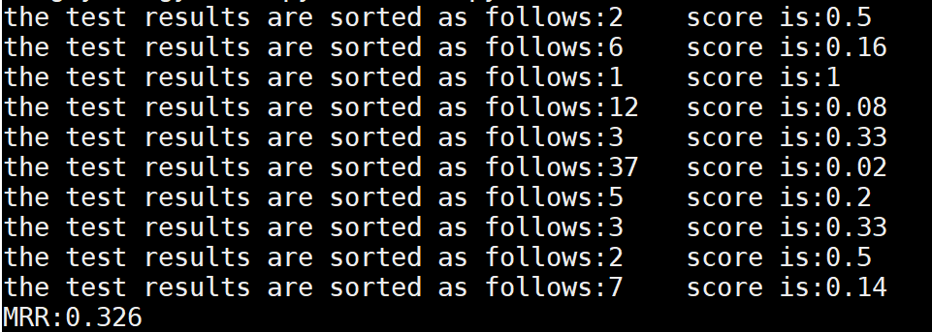
MRR
MRR test ：

Slide 3
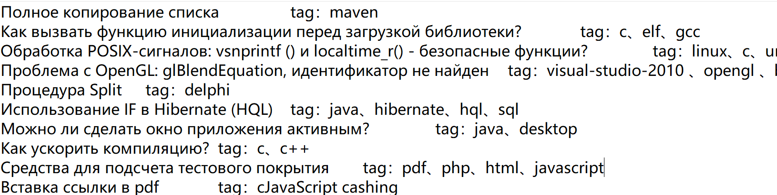
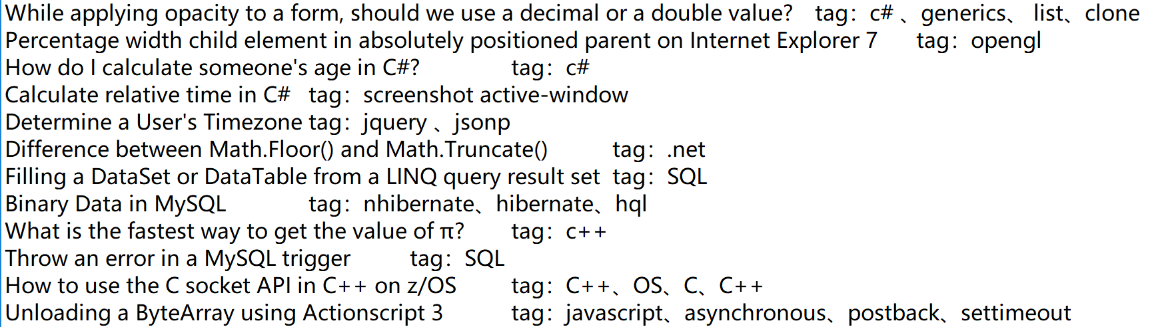
Tag correspondence analysis
data processing
problem：
answer：

Slide 4
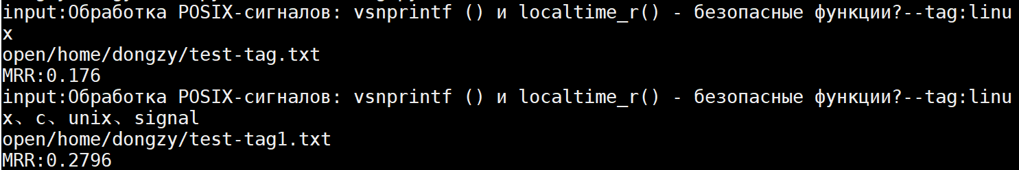
Tag correspondence analysis
Example
problem：Обработка POSIX-сигналов: vsnprintf () и localtime_r() - безопасные функции?
关键字：tag：linux、c、unix、signal
 | Tag=1 | Tag》1
MRR | 0.186 | 0.291

Slide 5
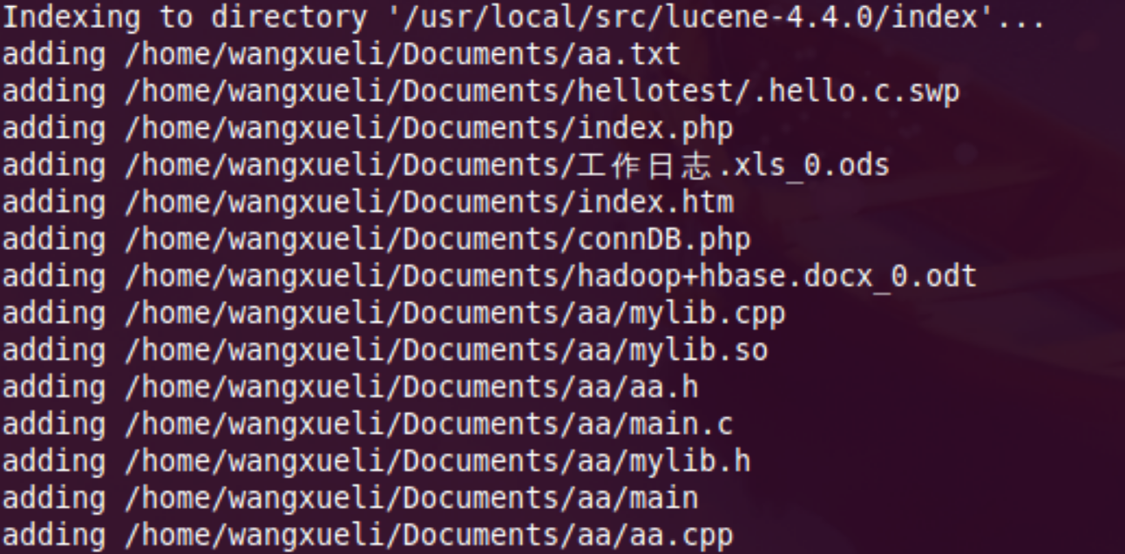
Lucene
（1）Lucene Environment settings

Slide 6
Lucene
（2）test
Example
Russian ：Как отобразить маршрут на карте Google в приложении Android?
English：how to display the route on the map in the annex google android?
Result ：
Enter query: lucene
Searching for: how to display the route on the map in the annex google android?
357 total matching
1. Map Routing, a la Google Maps?
2. Has anybody used Google Performance Tools?
3. Options for Google Maps over SSL
4. Simplest way to make a Google Map mashup?
5. Google Maps API - Problems with class GLatLngBounds
6. Best way to fix CSS/JS drop-down in IE7 when page includes Google Map
7. How can I launch the Google Maps iPhone application from within my own native application?
8. Should I use Google Web Toolkit for my new webapp?
9. Fixed Legend in Google Maps Mashup
10. Best .NET Wrapper for Google Maps or Yahoo Maps?
11. What does Google Chrome mean to web developers?
（3）MRR=0.474（ Test ten times ）

Slide 7
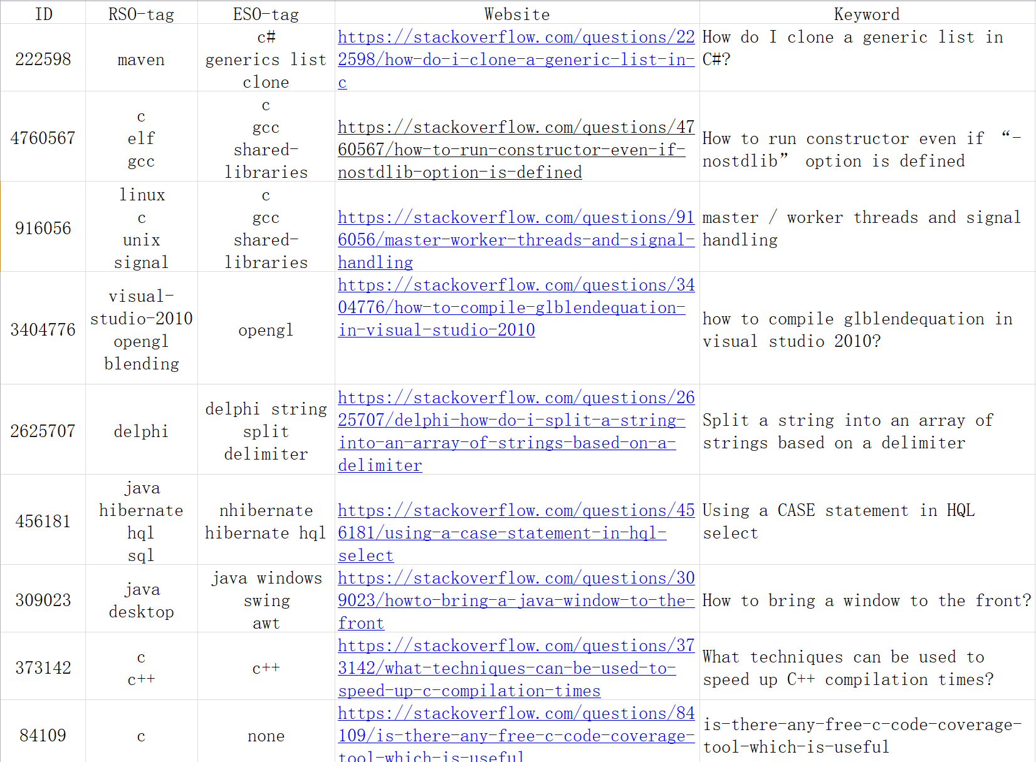
Tag correspondence analysis
data quantity ：5346

